Slide 1
Transaction Management with Spring Boot and Spring Data JPA (@Transactional Annotation)

Slide 2
Transaction Management with Spring Boot and Spring Data JPA
How Spring Data JPA provides a default transaction management
Create Spring boot project step by step and implement Transaction Management using @Transactional (We will take eCommerce place order use case

Slide 3
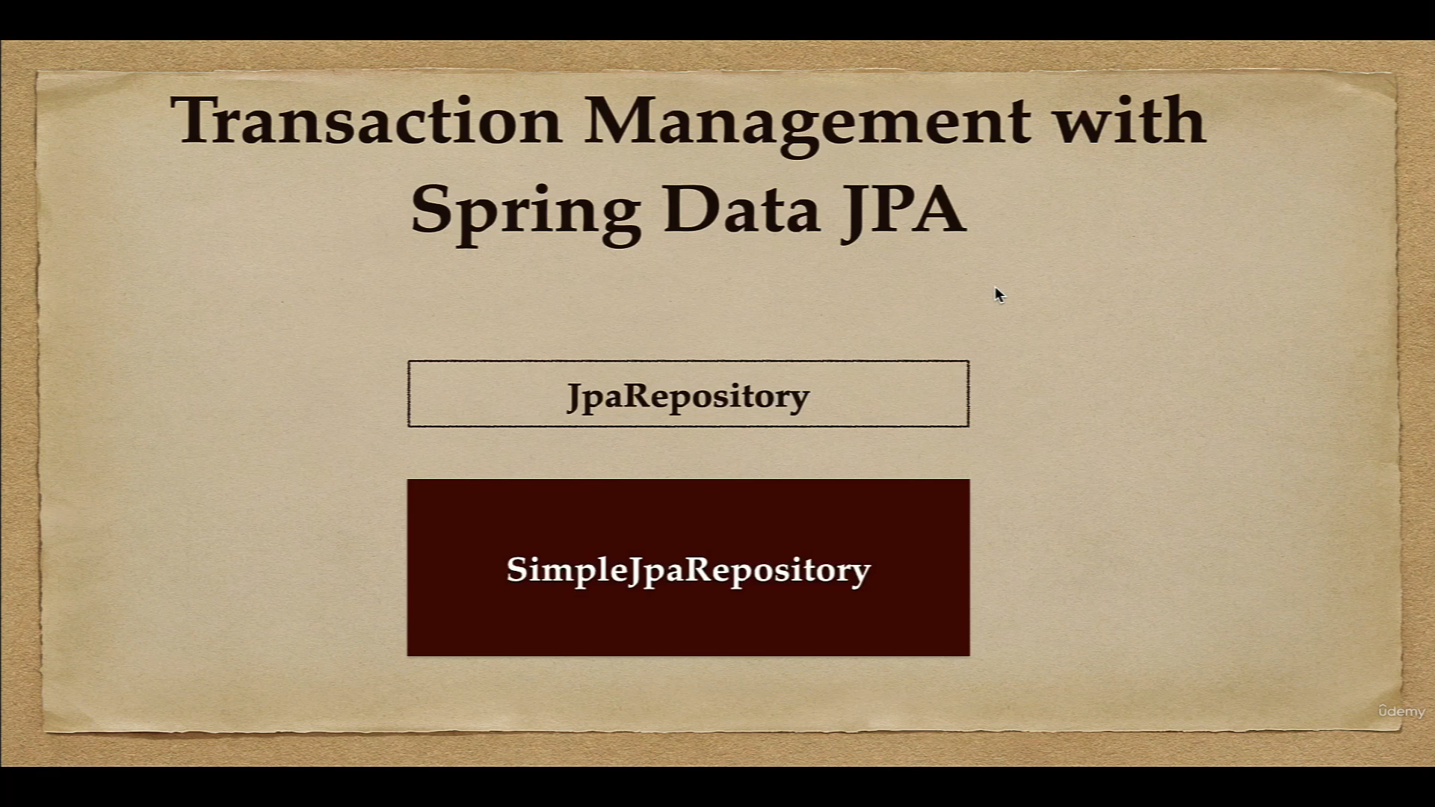
In Spring Data JPA, SimpleJpaRepository is used as the default implementation of JpaRepository
Spring Data JPA, by default provides transaction management for it’s CRUD methods

Slide 4


Slide 5
